Slide 1
Predicting Ethereum
A study into the future value of Cryptocurrency
John Neville
Regis University

Slide 2

What is Ether?

Slide 3
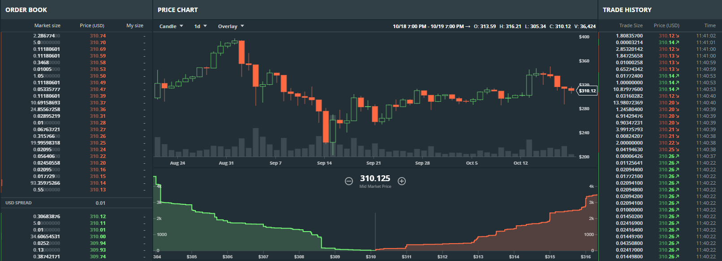
How do you determine the value of Etheruem?
https://www.gdax.com/trade/ETH-USD

Slide 4
Getting the Data

Slide 5
Data Engineering

Slide 6
Exploratory

Slide 7
Models To Evaluate
ARIMA
FBProphet – Timeseries analysis, software provided by Facebook
Linear Regression
Ridge Regression
Lasso Regression
XGB Boost – Linear Regression

Slide 8
Model Selection

Slide 9
Results

